Slide 1
Introduction to a few key UCSB web services: Umail, GOLD, and BARC,

Slide 2
Umail – Your University Email Account
http://www.umail.ucsb.edu/
Official email account with UCSB.
All university correspondence is done through umail.
You are responsible for checking your umail account regularly
Check your umail throughout the summer! We will ask you about your test scores and other coursework.
Do NOT forward your umail – when forwarded, important mail may be marked as spam.

Slide 3
GOLD – Gaucho On-Line Data
GOLD is the system through which you will:
Enroll in classes
Check your grades
Track your progress
GOLD web address: https://my.sa.ucsb.edu/gold/
DO NOT SHARE YOUR PASSWORD

Slide 4
Demo videos available under Help.
Check your GOLD messages and your umail. This is how UCSB will correspond with you. It is your responsibility to check these messages!

Slide 5
Keep your address and phone number up to date
To change your preferred first name go to https://secure.identity.ucsb.edu/editor/.

Slide 6
Course Enrollment

Slide 7
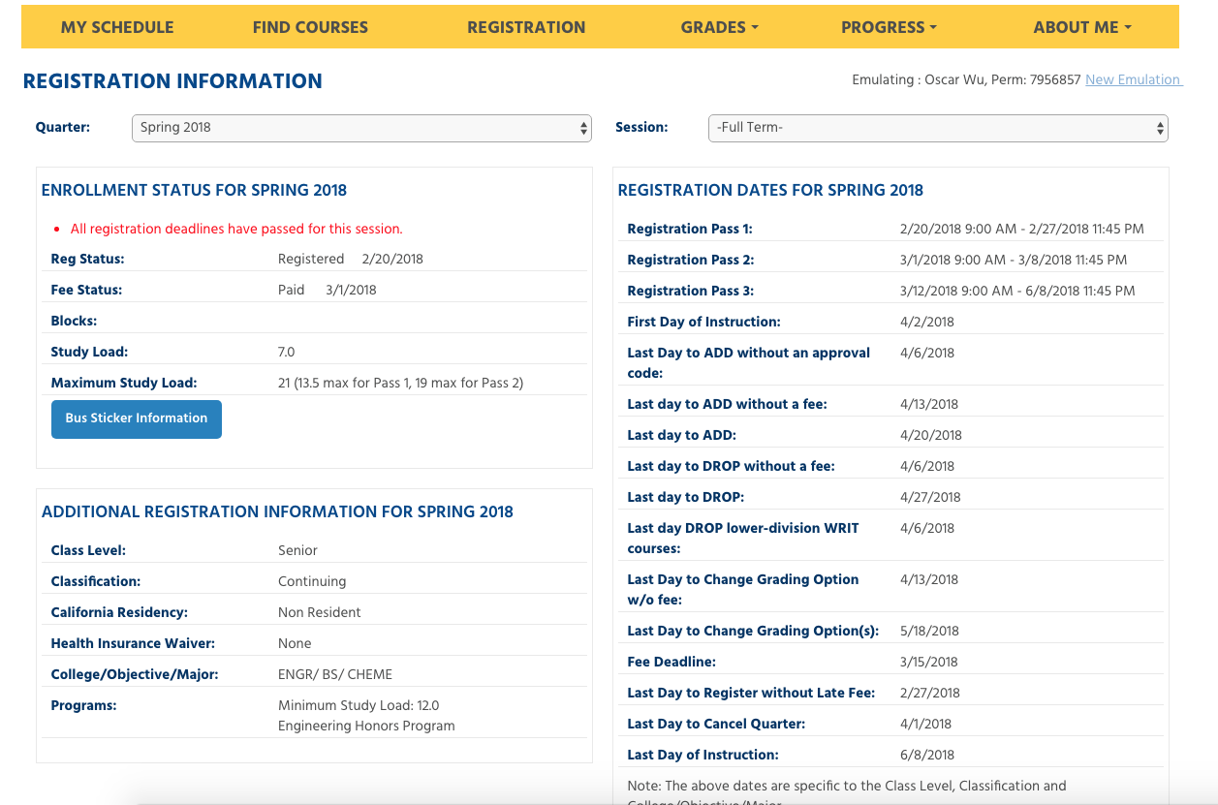
Check for your pass times for the following quarter around the third week of the current quarter. You want to register for your classes on the first day of your pass 1. Classes fill quickly.
Pass times

Slide 8
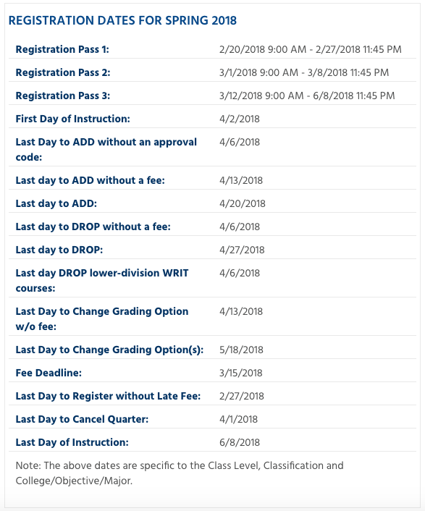
You will be charged $50 if you do not register during your first assigned pass.
Each pass time has a registration unit limit.
Pass 1: Up to 13.5 units.
Pass 2: Up to 19 total units.
Pass 3: Up to 21 units total.
You get three registration appointment times and can only adjust your schedule during these times.
Check all deadlines to adjust your schedule accordingly. The College of Engineering is very strict about these deadlines. You will not be permitted to drop a course after the drop deadline.

Slide 9
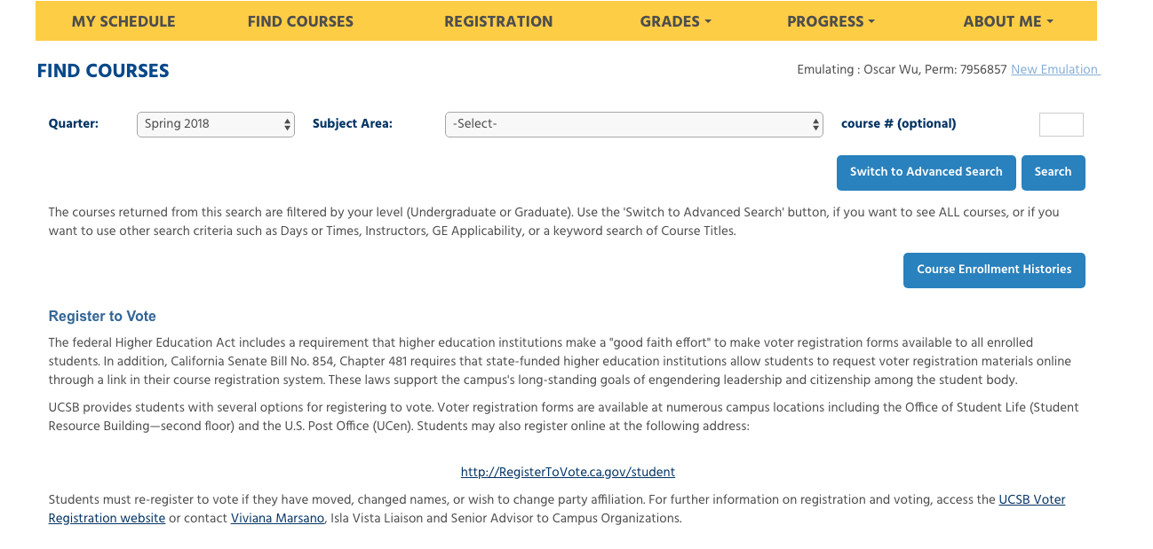
When adding courses to your schedule this is where you would begin.
Pick the appropriate quarter.
Advanced search can help you find open courses or courses that satisfy specific GE areas.

Slide 10
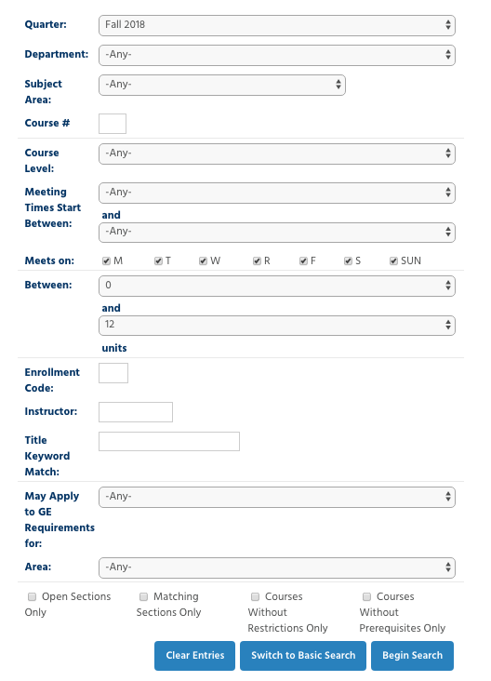
Advanced Search
Advanced search can help you find open courses or courses that satisfy specific GE areas.

Slide 11
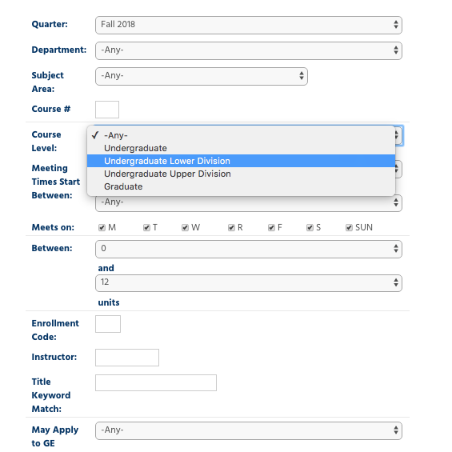
Undergraduate lower division courses are numbered 1-99. Only take lower division courses your first year.
Undergraduate upper division courses are numbered 100-199.
Graduate level courses are numbered 200-500 and require a petition for undergraduates to be considered for enrollment.

Slide 12
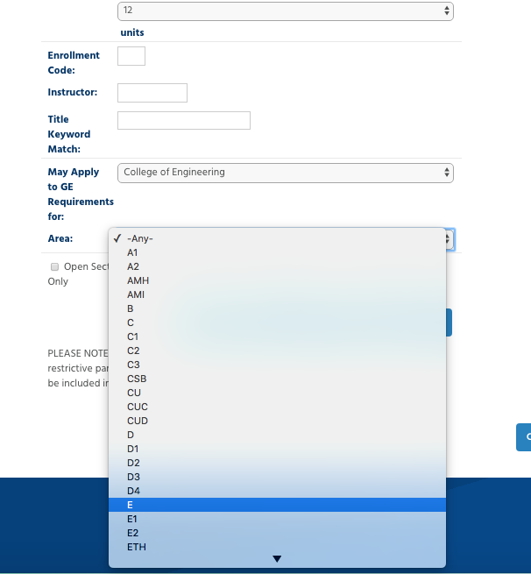
Change to College of Engineering
Pick specific GE area or special subject area that needs to be met.

Slide 13
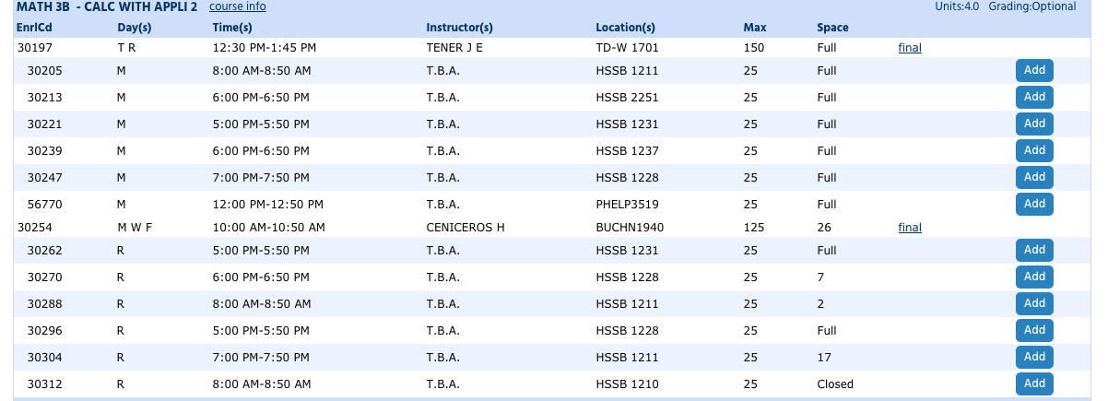
Add a course
Most courses have a lecture and a separate discussion section. Enroll through the discussion section.
LECTURE
LECTURE
LECTURE
SECTIONS
LECTURE
SECTIONS

Slide 14
Course full? Sometimes you can wait list.
Click on waitlist

Slide 15
Check sections that fit in your schedule

Slide 16
View your schedule

Slide 17
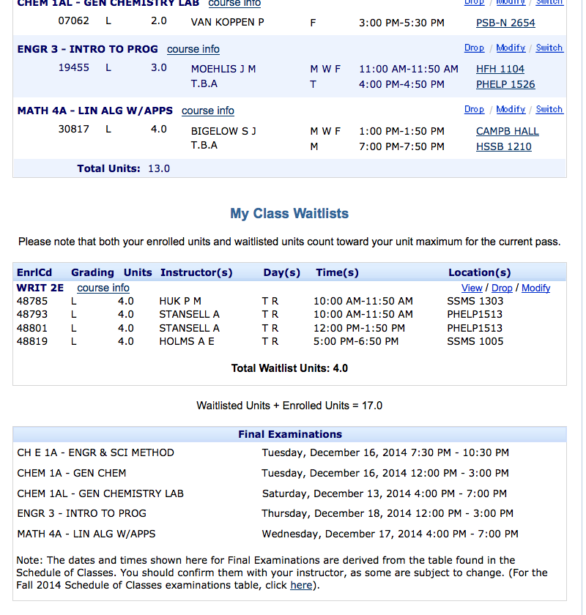
Courses you are enrolled in are up here.
Conflicting courses will he highlighted in red – you are required to resolve conflicts.
Any waitlists you added will be listed here.
Final Exam information.
You should also check your syllabus. You must be able to attend the final.

Slide 18
Once you are registered you can adjust your current classes from this screen as well.
Drop: Before the deadline you can drop as long as you do not fall below 12 units
Modify: Allows you to change your grading option (letter graded vs. P/NP).
Switch: Change your discussion/lab time. Do not drop a course if you are enrolled and want to just change the time – use switch!
All courses for your major must be taken for a letter grade!!!

Slide 19
Track your progress
“Degree Audits”

Slide 20
Step 1: Click Progress
Step 2: Click Major & GE Progress Checks

Slide 21
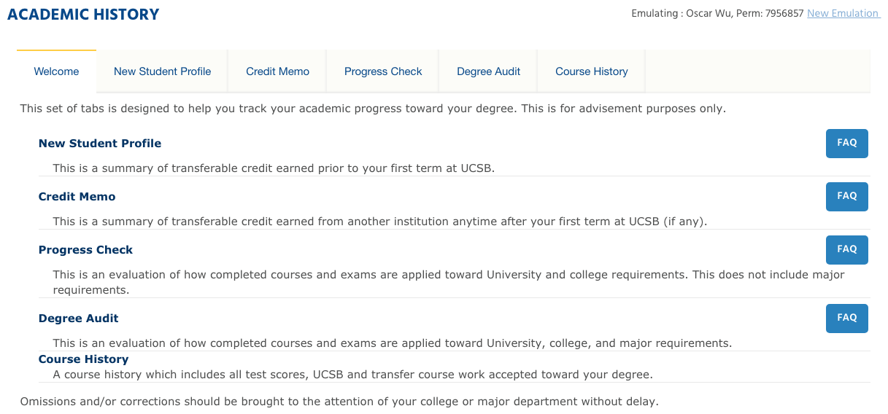
Step 3: Click Degree Audit

Slide 22
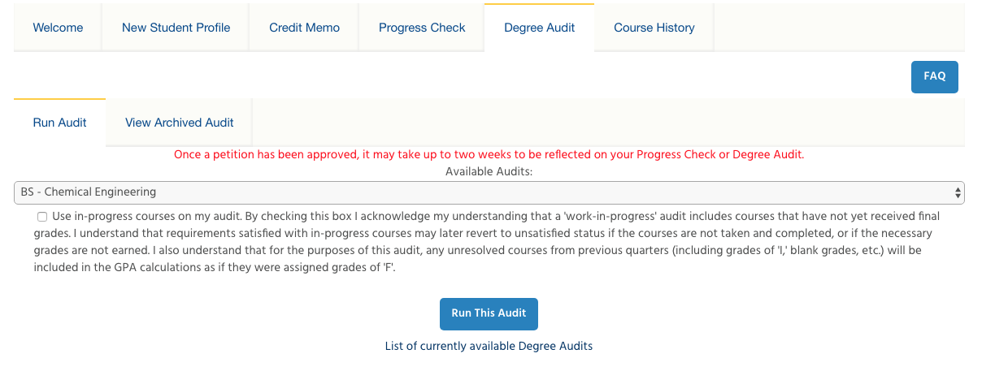
Step 5: Click Run This Audit and wait.
Step 4: You can run the audit so that it will show courses you are currently enrolled in as completed, or not.

Slide 23
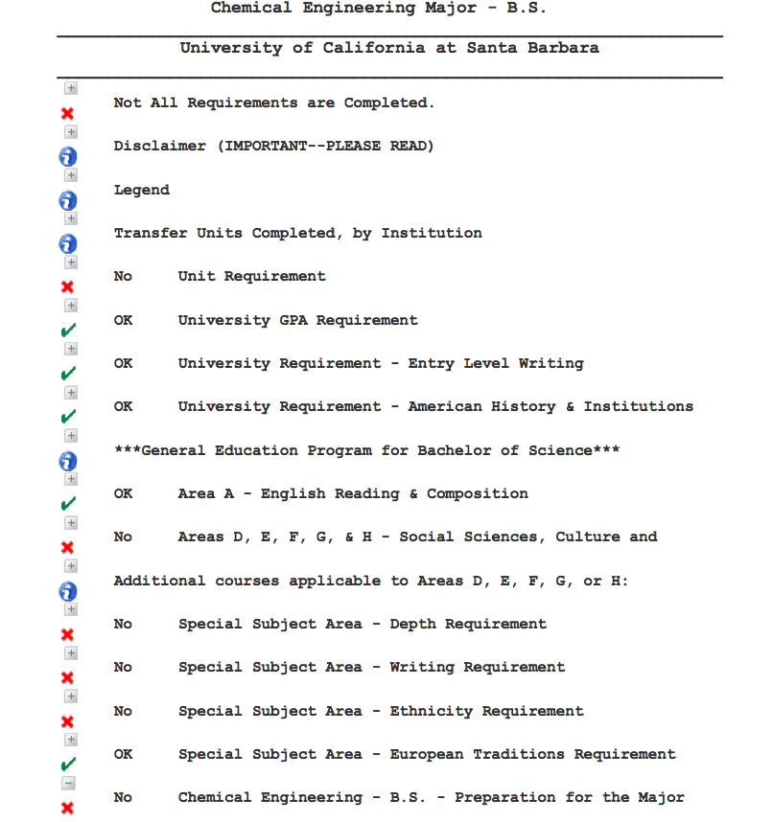
A green check indicates an area is fulfilled.
A red X indicates an area is not complete.

Slide 24
BARC – Paying your tuition
BARC is the system through which you will:
Pay your tuition and fees
BARC web address: https://mybarc.ucsb.edu/
You can also set up a BARC account for your parents to view and/or pay your bill
Financial Aid packages are at https://www.finaid.ucsb.edu/aidstatus/

